Slide 1
ZOMBIE TRAILS
Maxine Hood, Sherry Xu

Slide 2
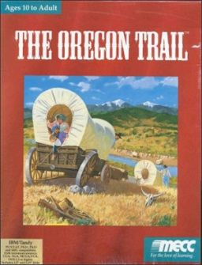
Backstory
Zombie adaptation of the popular 70’s game Oregon trail
You’ve been bitten by a zombie, and you have 30 days to reach Oregon, where the cure is located.

Slide 3
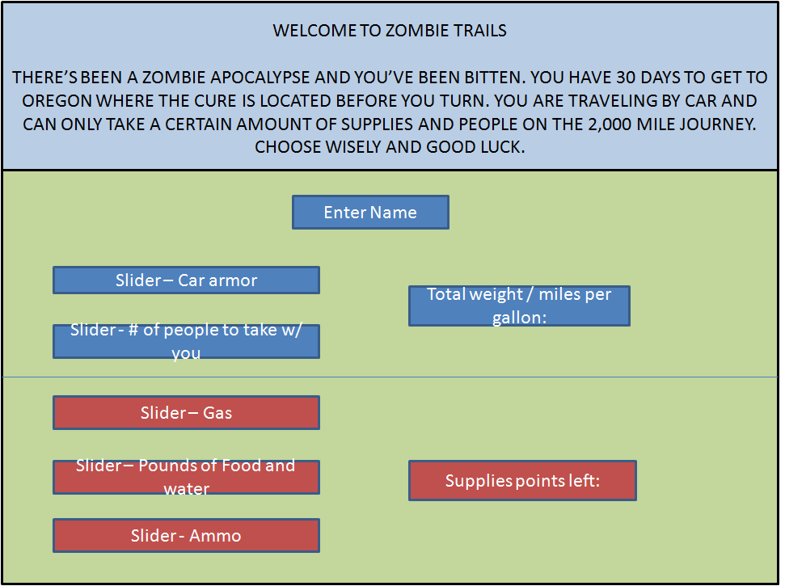
Gameplay
Start menu
Certain resources weigh more than others.
Weight effects travel speed.

Slide 4
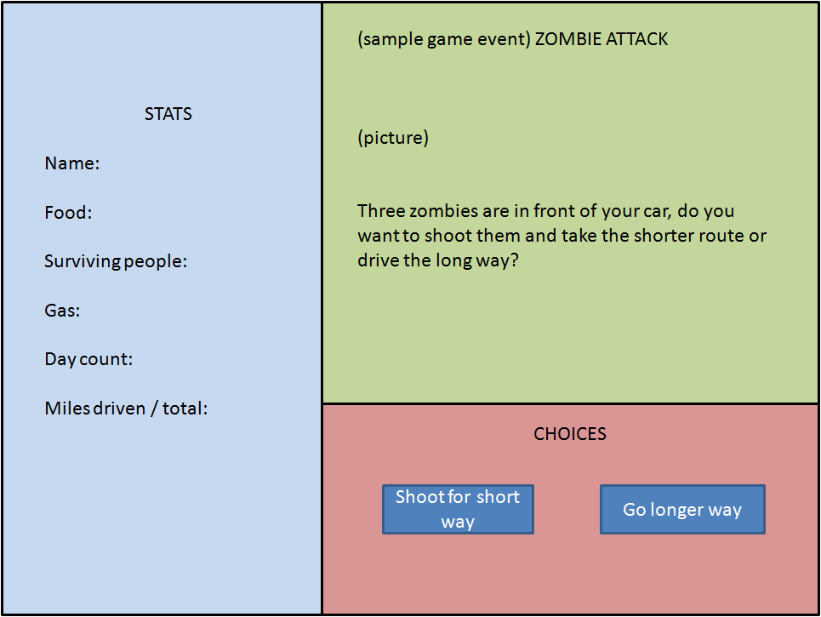
Gameplay
Game/Event Panel
Each event has two choices
Alternate between city events and random events

Slide 5
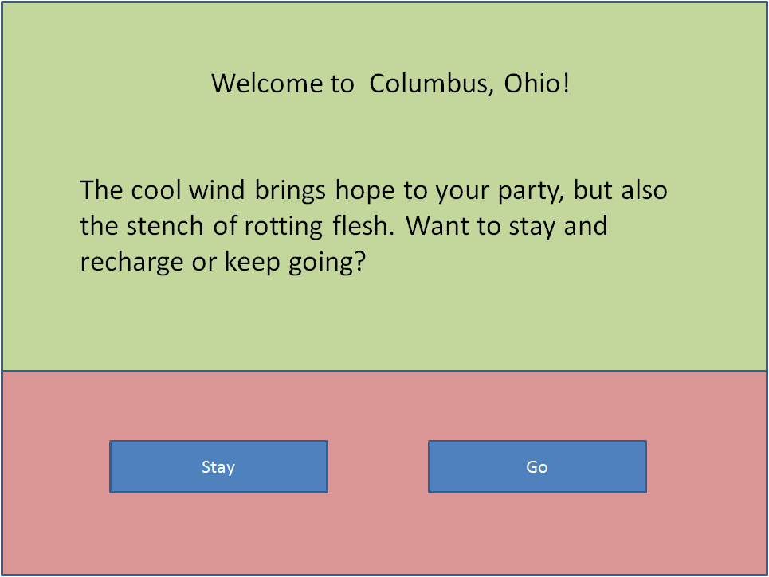
Example
Event

Slide 6
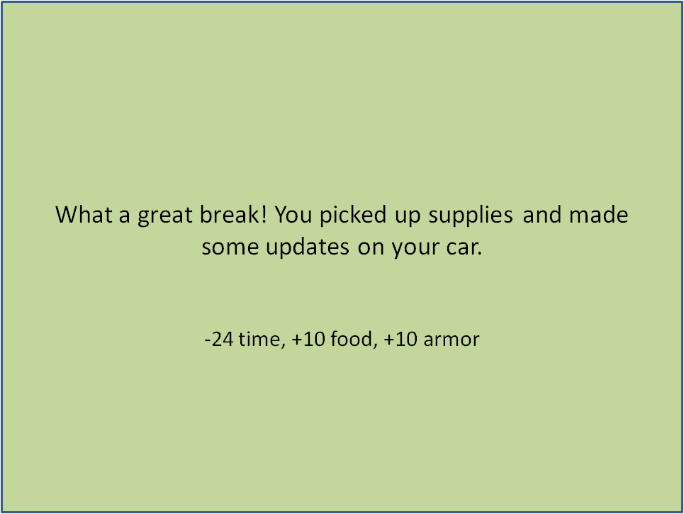
Example
Event

Slide 7
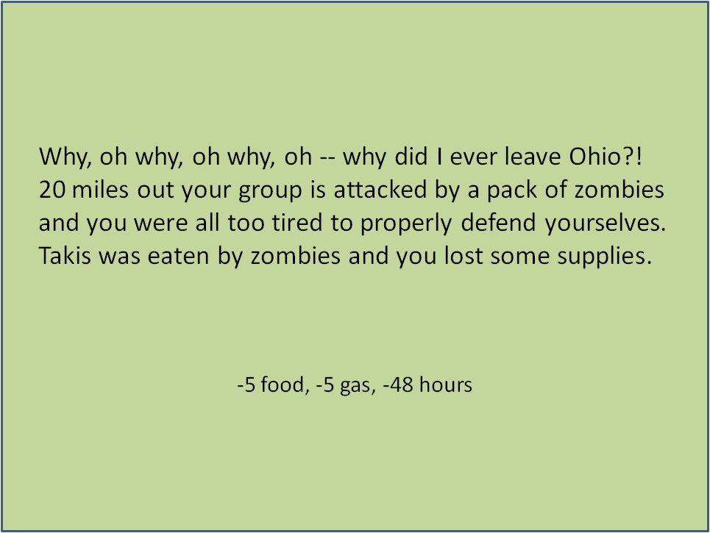
Example
Event

Slide 8
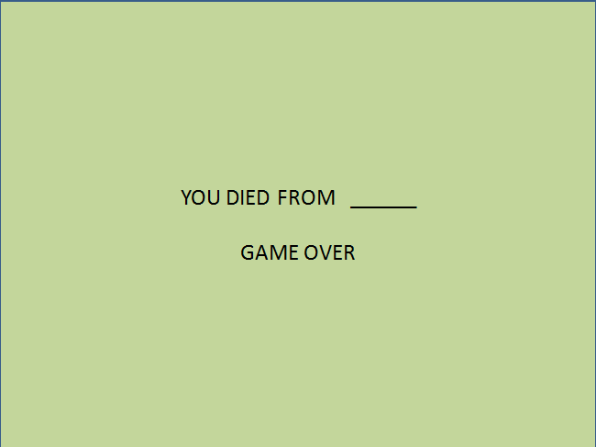
Losing the Game
The player loses the game when food, gas, or time goes down to 0.

Slide 9
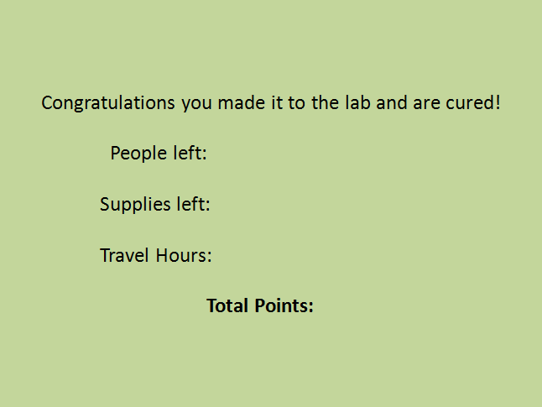
Winning the Game
Win the game when you make it through all the city and random events without the food and gas hitting 0. Points are then calculated based on how much time it took, how many supplies are left, and how many people are left.

Slide 10
Data Structures
Linked List
City events
Predetermined order of city events stored via linked list.
User traverse one by one in order.
Random Priority Queue
Random events added to queue with a random ( or not random ) priority.
Events to be added dependent on choices made in “city events”

Slide 11
Classes
Car: holds stats variables.
Events: used to store 10 - 15 possible random events; reads from text file.
Storyline: used to store the 9 city events; reads from text file.
Game: used to run the game.
GUI classes: control GUI and execute game.

Slide 12
Suggestions?

Slide 13
Thank You!

